Slide 1
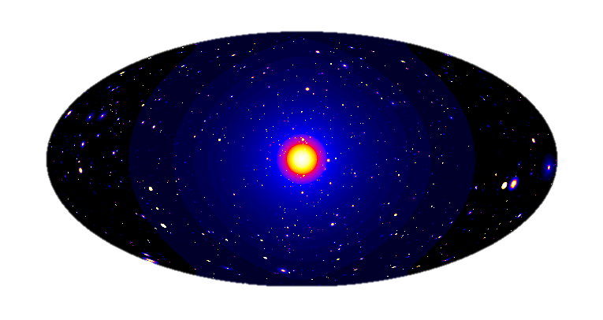
Hands-on session: How to search for Dark Matter with CTA?
Judit Pérez-Romero & Gabrijela Zaharijas
Cosmology and Astrophysics Center
University of Nova Gorica
judit.perez@ung.si

Slide 2
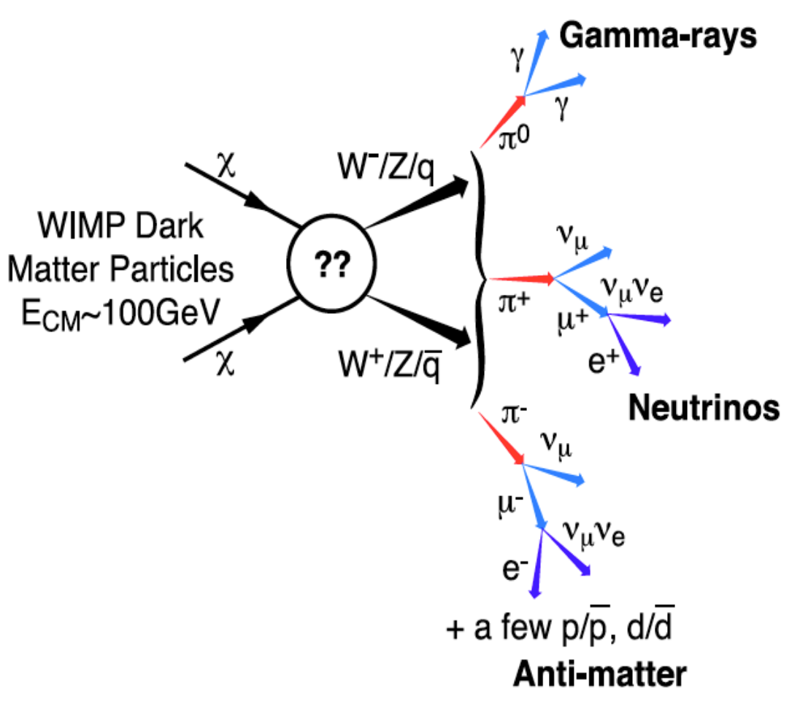
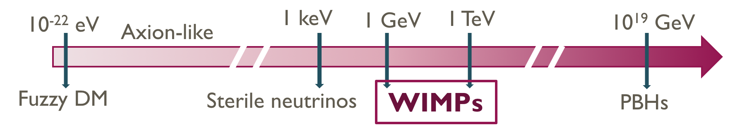
Dark matter through gamma-rays
Different DM candidates:
Component of
This 𝜸-ray emission allows to perform Indirect DM Searches with current telescopes
DM distribution in the Universe
ΛCDM Cosmology
Which are the optimal targets?
High DM density (𝜙_{DM} ∝ 𝜌_{DM}² for annihilation, 𝜙_{DM} ∝ 𝜌_{DM} for decay)
Massive nearby objects (𝜙_{DM} ∝ M/d_{Earth}²)
Low astrophysical background
Galactic Centre
Dwarf satellites
(dSphs)
Galaxy clusters
Pieri+09

Slide 3
The cherenkov telescope array observatory
Preliminary Performance Capabilities
https://www.cta-observatory.org/
Sensitivity
Angular resolution
CTA has superb capabilities for DM gamma-ray searches

Slide 4
Searching for dm with cta
Create a simulated observation of the galactic centre with DM signal
Analyze datasets provided
Analyze first dataset
Analyze second dataset

Slide 5
Searching for dm with cta
Create a simulated observation of the galactic centre with DM signal
Analyze datasets provided
Analyze first dataset
Analyze second dataset

Slide 6
Simulating cta DM observation
Basic input information to create ANY simulated data:
Livetime
Pointing
Region of Interest (ROI)
Energy range and/or binning
Instrument Response Functions (IRFs)
Model
Background model: from IRFs
Source model: can comprehend several sources, each of them has
Spectral model
Spatial model
Time model

Slide 7
Simulating cta DM observation
Basic input information to create OUR simulated data:
Livetime: 520 h
Pointing: galactic centre
Region of Interest (ROI): 20 deg x 20 deg
Energy range and/or binning: 10 bins from 20 GeV to 150 TeV
Instrument Response Functions (IRFs): Prod5-South-20deg-AverageAz-14MSTs37SSTs.180000s
Model

Slide 8
Simulating cta DM observation
Basic input information to create OUR simulated data:
Livetime: 520 h
Pointing: galactic centre
Region of Interest (ROI): 20 deg x 20 deg
Energy range and/or binning: 10 bins from 20 GeV to 150 TeV
Instrument Response Functions (IRFs): Prod5-South-20deg-AverageAz-14MSTs37SSTs.180000s
Model
Background model: from IRFs
Source model: only one DM source
Spectral model: WIMP annihilation
Spatial model: Template emission model for the galactic centre
Time model

Slide 9
Simulating cta DM observation
Basic input information to create OUR simulated data:
Model: Annihilation of Weakly Interactive Massive Particles (WIMPs)
Spatial model
Spectral model
Assumes ΛDCM model
Encodes how the DM is distributed in the object
We can use different 𝜌_{DM} parametrizations
Ends acting as a multiplicative factor to the overall flux
Encodes the spectrum of the emission
We can use the tables computed by [Cirelli+11]
http://www.marcocirelli.net/PPPC4DMID.html

Slide 10

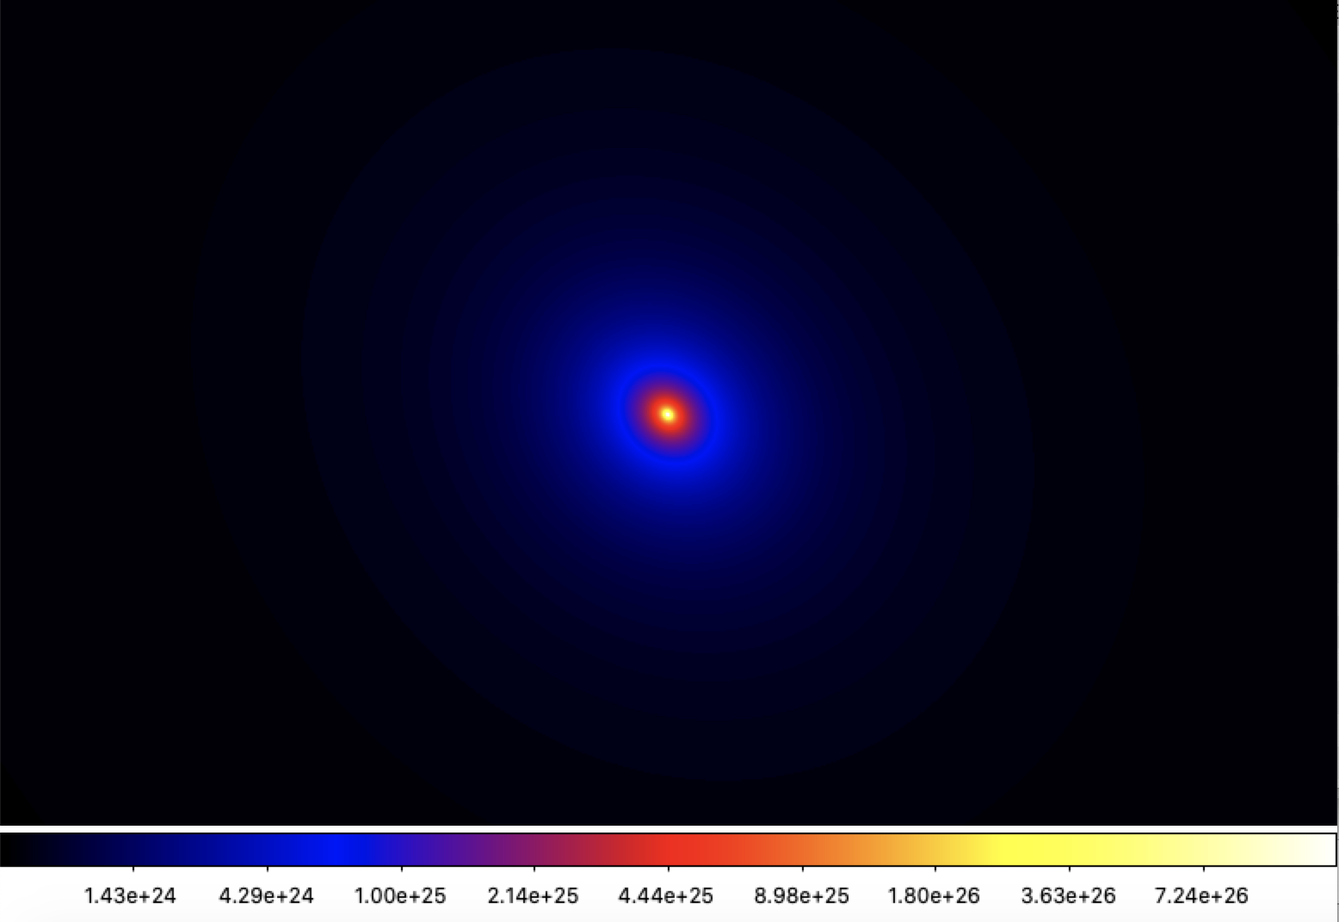
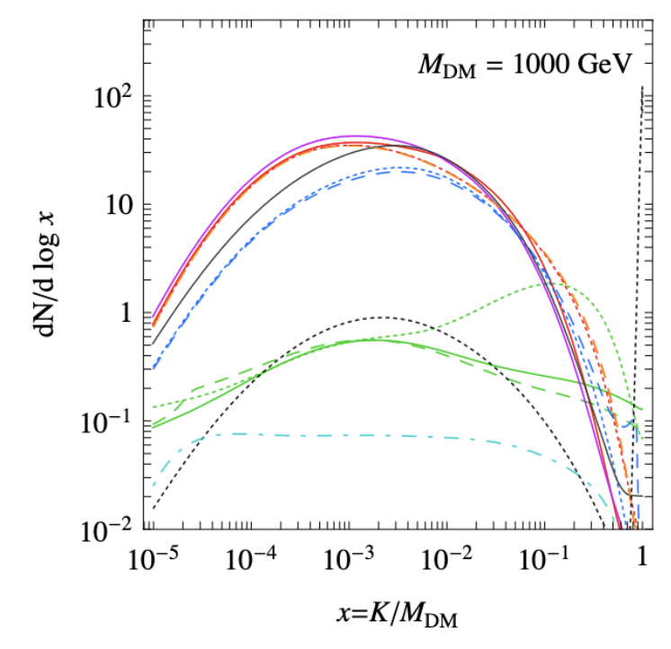
Simulating cta DM observation
Basic input information to create OUR simulated data:
Model: Annihilation of Weakly Interactive Massive Particles (WIMPs)
Spatial model
Spectral model
[Cirelli+11]
Gamma-ray emission spectrum from:
WIMP annihilation
m_{DM} = 5 TeV
bƃ channel
Created with CLUMPY software
[Charbonnier+12, Bonnivard+15, Hütten+18]
https://clumpy.gitlab.io/CLUMPY/

Slide 11
Searching for dm with cta
Create a simulated observation of the galactic centre with DM signal
Analyze datasets provided
Analyze first dataset
Analyze second dataset

Slide 12
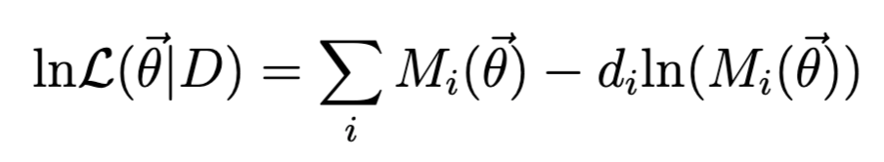
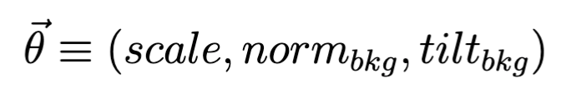
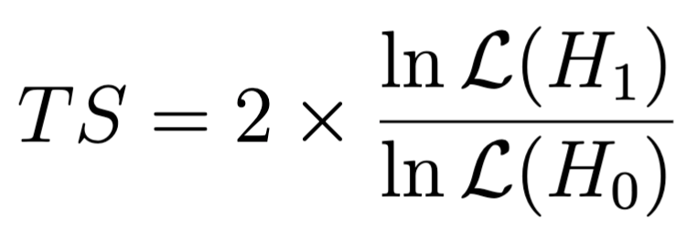
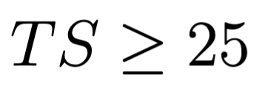
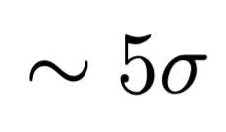
Analyze cta data searching for dm
Use maximum likelihood approach with a 3D fitting: 2 dimensions in space and 1 in energy
Cash statistics [Cash 79]
For the DM model
In the fit, we obtain as best values the ones maximizing the likelihood function
To test if a model is better than other to fit a dataset we use the likelihood ratio test (TS):
If H₀ is the null-hypothesis (only background), we determine a detection when
detection
[Li&Ma 83]

Slide 13
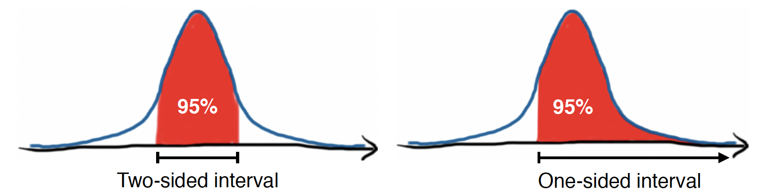
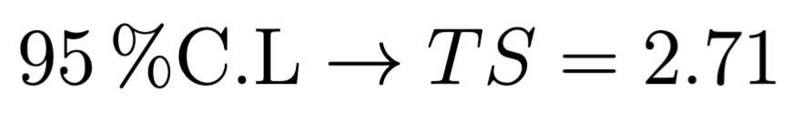
Analyze cta data searching for dm
We have not found a signal… Then let’s put constraints!
Likelihood profile
The likelihood has several dependencies but we are only interested in scale:
Project the likelihood to the parameter of interest
The limits can be one-sided or two-sided:
[picture by S. Fegan
for Fermi-LAT school]
This limits read as: the upper/lower value most probable to get by 95% of the times (if TS is distributed following a 𝜒²)
For the one-sided distribution
[Rolke+05]

Slide 14
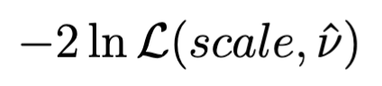
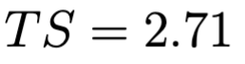
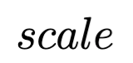
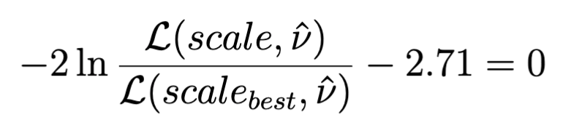
Analyze cta data searching for dm
We have not found a signal… Then let’s put constraints!
Likelihood profile
The likelihood has several dependencies but we are only interested in scale:
Project the likelihood to the parameter of interest
We need to solve:
[Rolke+05]

Slide 15
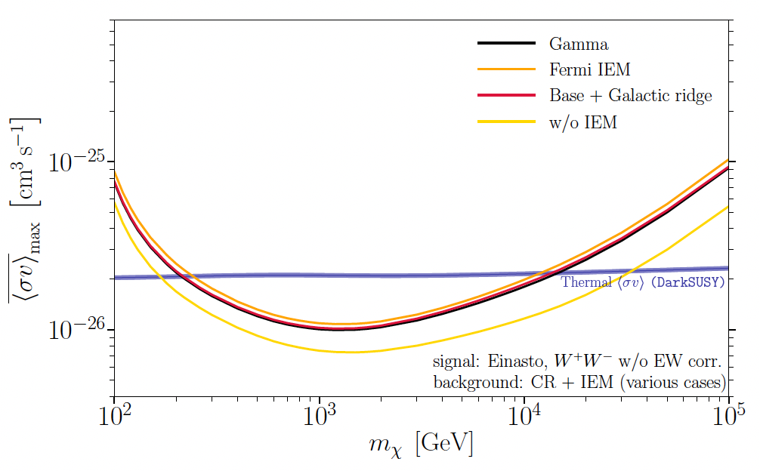
Analyze cta data searching for dm
Okey but, these are not the cool plots for constraints!
We have fitted our dataset to one channel and one mass. We will need to loop over the mass range of interest and the available channels to get these lines.
On top of that, we have only used one Poisson realization. To have statistically meaningful predictions, we need to average over O(300) realizations.
[CTA Cons. 21]
15 mass values x 3 channels x 300 realizations = 13500 fits!

Slide 16


Analyze cta data searching for dm
Most DM projects within CTA with same needs in terms of analysis tools and statistical treatment
Common set of tools
Unified definitions, methodology
Avoids repetition of same coding
Allows easy comparison of results.
Everyone can potentially contribute
Creation & coordination of DMTools Task Force within CTA
Gammapy software development
Since v-0.8 to v-1.0
(15 versions)
Gammapy embedded functions:
DarkMatterAnnihilationSpectralModel
GitHub repository:
Gammapy-DMTools
https://github.com/peroju/dmtools_gammapy
Gammapy coding sprints

Slide 17
Analyze cta data searching for dm
ON-OFF/Wobble Analysis
Template fitting
Standard for IACTs
State-of-the-art pipeline
Point-like
Extended
Minuit
MCMC
More complex and realistic than point-like approach
Benefits from CTA large FoV and angular resolution
Already embedded in Gammapy
Historically used fitter (iminuit) and very well documented (stability)
Flexible definition of likelihood and priors
Easy analysis of correlations
Lowest complexity
Most constraining results
Latin-American School on CTA Science – 30/03/2023

Slide 18
Analyze cta data searching for dm
Basic functioning of the pipelines
Input DM model
Spectral (based on Cirelli+11)
Spatial (point-like, analytical, FITS files)
Combine with observation set-up
IRFs
Observation time
Backgrounds
Simulated Observation
(Poisson realization)
Observation
Enter the DM fit loop
For each realization, consider a list of channels and for each, a list of DM masses
Perform a likelihood fit to this specific model
Check TS(H_{null}) ≥ 25
Compute <𝜎v> upper limits with TS(H_{best-fit}) = 2.71, bounded likelihood implemented
Latin-American School on CTA Science – 30/03/2023

